Slide 1
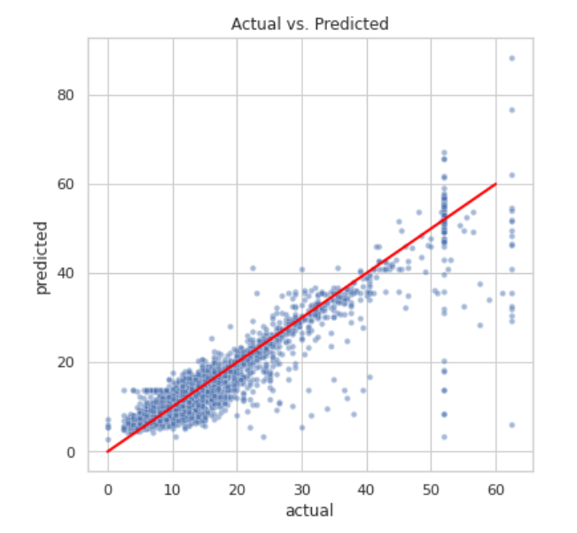
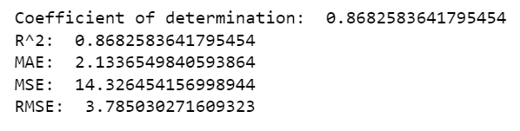
Results of Regression modeling
Executive summary report for New York City Taxi Limousine Commission
The New York City Taxi and Limousine Commission (TLC) contracted Automatidata to develop a regression model that helps estimate taxi fares before the ride. This part of project, Automatidata data team created a regression model deliverable.
The Automatidata data team chose to create a multiple linear regression (MLR) model based on the data provided.
This model performance is high on both training and test sets, suggesting that the model is not over-biased and not over-fit. In fact, the model performed better on the test data.
This model showed a successful model that estimates taxi cab fares prior to the ride.
In order to show this model performance, the Automatidata include a scatter plot comparing the predicted and actual fare amount.
The model performance is also shows that the evaluation metrics are high on the test sets.
This model can be used to predict the fare amount of taxi cab rides with reasonable confidence.
Imputing outliers optimized the model, specifically in regards to fare amount and duration variables.
This multiple linear regression model provides a sound framework for predicting the estimated fare amount for the taxi rides.
The greatest effect on fare amount was ride duration. The model revealed a mean increase of $7 for each additional minute.
The Automatidata request additional data from under represented itineraries.
The New York City Taxi and Limousine Commission can use this findings to create an app that allows users to see estimated fare before their ride begins.
The model provides a generally strong and reliable fare amount prediction that can be used in downstream modelling efforts.

